Slide 1
QMST 5335
Module 2.3
Introduction to Simulation

Slide 2
Queueing Theory vs. Simulation
For complex queueing systems, we do not have much results
  So, what can be done?
  Approximation characterizations…Simulation can be used!
Why study Queueing Theory with Simulation?
  Terminology, logic similar to many simulation models
  In some cases, can derive exact closed-form formulas for output performance metrics, use to verify (debug) simulation models:
    Have simulation model of complex system that does not meet queueing-theory assumptions … but it would if we made some (over-)simplifying extra assumptions like exponential distributions for inter-arrival and service times
    Modify the simulation model so that it meets these extra assumptions, run it for a very long time … queueing-theoretic results are typically available only for steady state (a.k.a. long run, infinite horizon)
    Compare simulation output with queueing-theoretic results … if they (approximately) agree, then confidence in the simulation is improved.
    Restore your simulation model back the way it should be!

Slide 3
Queueing Theory vs. Simulation
Queueing Theory vs. Simulation
  Queueing-theoretic results have the advantage of being exact, i.e., no statistical uncertainty/variation
    Simulation results have statistical uncertainty/variation, which needs to be acknowledged and appropriately addressed
  But queueing theory has its own shortcomings:
    Strong assumptions that may be unrealistic, like exponential service times (mode = 0?), making model validity questionable
    Nearly always only for steady-state long-run behavior, so don’t address what happens in the short run
    Not available for all inter-arrival/service distributions, or (more importantly) for complex systems (Jackson network is simple, restrictive)
  Despite output uncertainty, simulation has major advantages:
    No restrictions on input distributions, model form, or complexity … so model validity is facilitated
    Can address short-term time frames … in fact, steady-state is harder for simulation (long runs, initialization bias) than for queueing theory
    Just have to be mindful of proper statistical design/analysis

Slide 4
Learning Objectives:
Understanding systems/models and how simulation works
Learning the basic components of simulation
Learning when simulation can be used
Understanding the key factors in using simulation effectively

Slide 5
Outline
Simulation Process
  Simulation, Systems and Models
  Randomness and the Simulation Process
Simulation Approach
  When to Simulate (and When Not to)
  Simulation Success Skills
Review and System Examples

Slide 6
Outline
Simulation Process
  Simulation, Systems and Models
  Randomness and the Simulation Process
Simulation Approach
  When to Simulate (and When Not to)
  Simulation Success Skills
Review and System Examples

Slide 7
Simulation
Some definitions:
  From dictionary.com
    imitation or enactment, as of something anticipated or in testing.
    the act or process of pretending; feigning.
  From Wikipedia.com
    A simulation is an approximate imitation of the operation of a process or system
Some history:
  In use since 1960s, continues to grow, strengthen
  During WW2, it is used to study random neutron diffusion in connection with the development of atom bomb
  The basics lie in statistical sampling, random numbers, random sampling
A very useful tool:
  It is used very widely in many manufacturing and service industries
    Manufacturing systems, transportation analyses, healthcare, almost any service industry!
  A crucial and relatively easy to use modeling tool to analyze a system

Slide 8
Systems and Models
System – broad term, set of related components working together toward some purpose, usually over time
  Simple ATM; complex airport; very complex global distribution network
  For any system, it is necessary and sometimes essential to understand how it will behave and perform under various configurations and circumstances
    You can carefully observe the system over time
      But it will take long time and, sometimes, it might be impossible to observe the system under each possible configuration
    Also, how about when you want to make changes in the system and see what happens?
      Do the change and observe?
      Timely and might be costly (for instance, trying out a new high-tech machine in the manufacturing shop?) → Not very practical
    Or, how about if the system does not exist yet?
      No observation is possible!
      Build the system and observe? → not practical
As systems can be complicated, we use models to understand the systems

Slide 9
Systems and Models
Model of a system: a representation of a system
  Physical model – airplane cockpit for training, wind tunnels, a model car
    These can be used to collect information about the system
    For instance, car prototypes (physical model of the car) are used in safety testing
  Analytical model – exact mathematical analysis, limited domain/flexibility
    Sometimes it is possible to explain the relations within a system mathematically!
    For instance, the amount of materials required by a specific product design can be related to the volume, which can be expressed mathematically using the design specifications
    For complex systems, generating analytical models can be impossible, especially considering the uncertain environmental factors
  Simulation model – Imitation of a system’s operation over time (dynamic)
    Appropriate level of detail, draw conclusions about system behavior
    Software to represent system components, behavior, interactions
    Record artificial “history” of model, summarize characteristics
    Used to predict effect of changes to existing system, or performance of new systems

Slide 10
Systems and Models
Types of simulation: follow types of systems
Stochastic vs. Deterministic
  Deterministic – no random inputs to model, so outputs are always the same (unless you change something in the model)
  Stochastic – random inputs to model to represent the realistic variation found in most systems (time to complete a task, time between successive arrivals of customers, machine uptimes and downtimes, branching probabilities)
    Outputs random too, subject to proper statistical analysis
Static vs. Dynamic
  Static – the time does not affect the system and its operation
    Analyzing how much you can win in a gambling game → can generate outcomes randomly and see what happens
  Dynamic – the operations are depending on the time
    It is impossible to model the system without time dimension
    Operations/processes are related to each other over time
    A queueing system: customer’s interarrival times, customer service times, etc.

Slide 11
Systems and Models
Types of simulation: follow types of systems
Discrete vs. Continuous
  Discrete – state variables describing the model change only at instantaneous discrete points in time (event times)
    Number of customers in queue, server status (busy, idle, down)
  Continuous – state variables can change continuously over time, described by differential equations that are solved numerically
    Pressure in a tank, temperature in an oven, fluid flow
  Mixed discrete/continuous models

Slide 12
Systems and Models
Discrete simulation paradigms: approaches to create simulation models
  Events (events-based simulation)
    Model the points in time when the system state can change
    Program to carry out instantaneous event logic, scheduling of future events, observing output and summaries
  Processes (process-based simulation)
    Model a sequence of actions taking place over time (part in a manufacturing system seizes a worker, delays for service, releases worker)
  Objects (object-oriented simulation)
    Describe model from the point of view of the facility
    Agent-based (agent-based simulation)
      Agents are a special case of objects
      Give intelligence to objects to make them into agents
      System behavior emerges from interaction of many autonomous agents
  No strict distinction: many software combine these paradigms

Slide 13
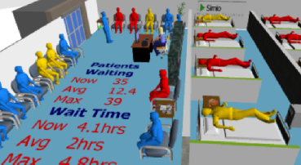

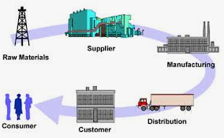

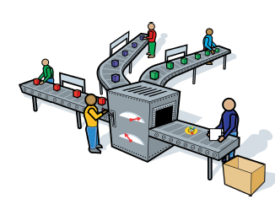
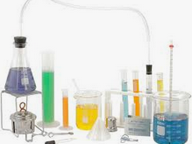
Systems and Models
Some (only some) examples of use of simulation
  Some service industry examples: Restaurants, Drive-through, Amusement Parks, Call Centers, Banks, Customer Service
  Healthcare industry examples: surgery scheduling, hospital staffing, resource management, capacity planning
  Supply chain examples: inventory control, deliveries and shipments, demand management, marketing
  Transportation examples: Ports, Airports, Flight schedules, traffic planning, signalization, speed control
  Manufacturing examples: assembly lines, production systems, quality control
  Physics/Chemistry: fluid mechanics, chemical reactions, physical systems
  Many other examples: mining, public sector, telecommunications, emergency response…

Slide 14
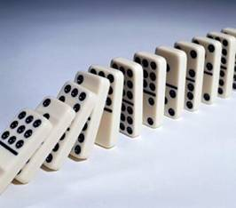
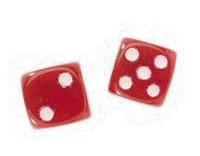
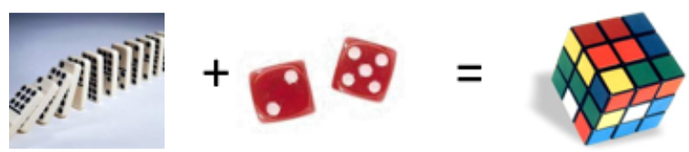
Systems and Models
Why simulation?
  We need to study systems
    To design new systems, improve system performance, solve problems affecting the system
  We use models to study systems
    Physical models (not suitable for large complex systems), analytical models (if we can analytically model the exact system, we will use the analytical model), simulation models (when the analytical models are not exact or do not exist at all)
    So, in many cases, we need simulation models to study the (typically complex) systems
      The objects and process are related
      There is randomness (breaks, failures, environmental changes, etc.)
      Combined relations and randomness make analyses complex
      Simulation is uniquely capable of managing this complexity.

Slide 15
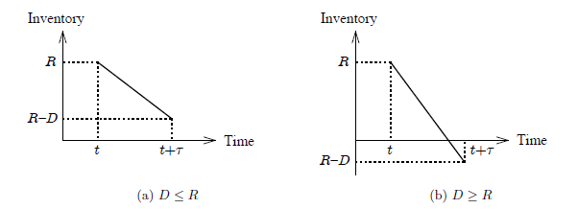
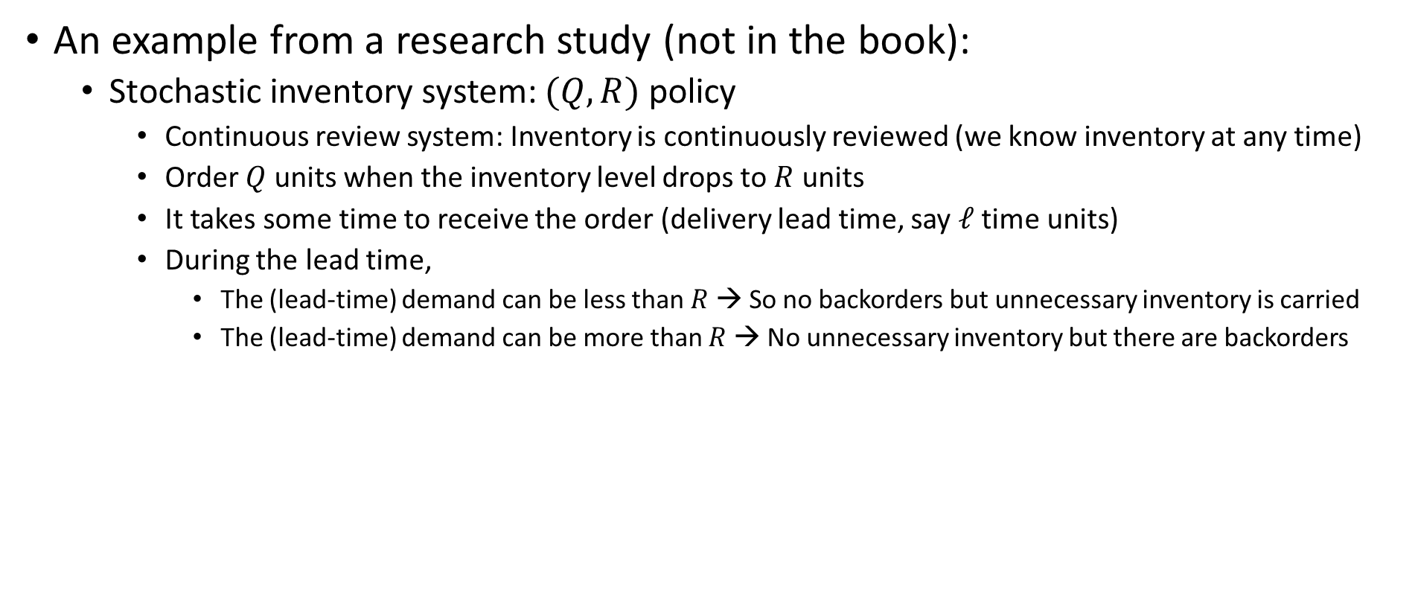
Systems and Models
An example from a research study (not in the book):
  Stochastic inventory system: $(Q,R)$policy
    Continuous review system: Inventory is continuously reviewed (we know inventory at any time)
    Order $Q$ units when the inventory level drops to $R$ units
    It takes some time to receive the order (delivery lead time, say $ℓ$ time units)
    During the lead time,
      The (lead-time) demand can be less than $R$ → So no backorders but unnecessary inventory is carried
      The (lead-time) demand can be more than $R$ → No unnecessary inventory but there are backorders
D is the random demand during the lead time

Slide 16
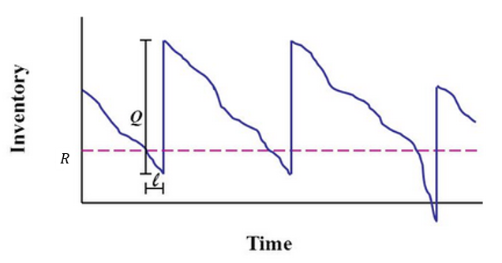


Systems and Models
An example from a research study (not in the book):
  Stochastic inventory control: $(Q,R)$policy
    The objective is to find Q and R values to minimize expected costs per unit time
    There is an analytical model to minimize the (approximated) expected costs per unit time
No backorder but excess inventory
No backorder but excess inventory
No excess inventory but backorders
Exp. Inventory holding cost
Exp. Ordering cost
Exp. Backorder-Penalty cost

Slide 17
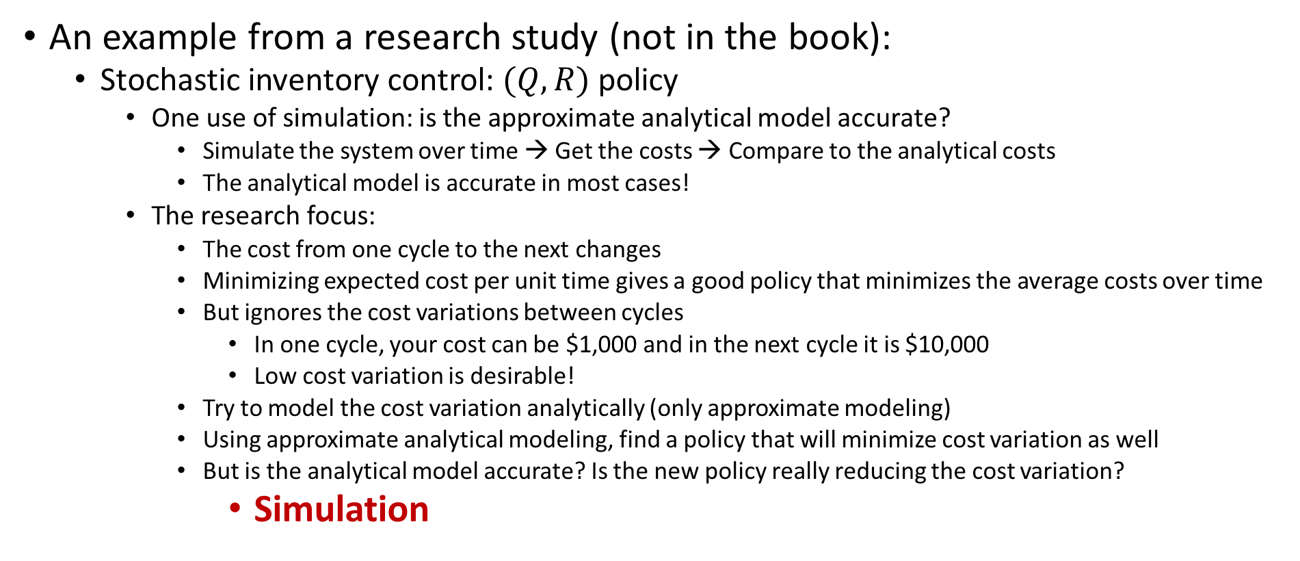
Systems and Models
An example from a research study (not in the book):
  Stochastic inventory control: $(Q,R)$policy
    One use of simulation: is the approximate analytical model accurate?
      Simulate the system over time → Get the costs → Compare to the analytical costs
      The analytical model is accurate in most cases!
    The research focus:
      The cost from one cycle to the next changes
      Minimizing expected cost per unit time gives a good policy that minimizes the average costs over time
      But ignores the cost variations between cycles
        In one cycle, your cost can be $1,000 and in the next cycle it is $10,000
        Low cost variation is desirable!
      Try to model the cost variation analytically (only approximate modeling)
      Using approximate analytical modeling, find a policy that will minimize cost variation as well
      But is the analytical model accurate? Is the new policy really reducing the cost variation?
        Simulation

Slide 18

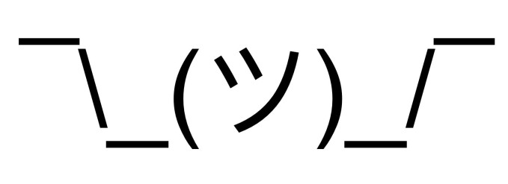
Randomness and Simulation Process
Randomness is present in most of the systems
  Demand by customers, parts
  Equipment/personnel failures
  Shortages of materials/supplies.
Randomness is an important aspect of most systems.
  Process times, entity arrivals, service times
We cannot know the outcomes with certainty
  Using estimates can be invalid
  We can model probabilities associated with random outcomes
  Makes creating analytical models difficult or impossible
Simulation models can handle randomness!

Slide 19
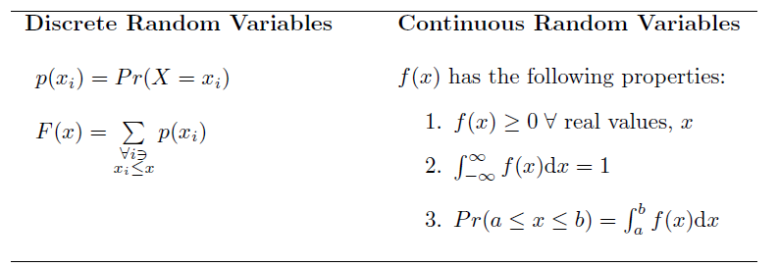
Randomness
Random variables: a random variable’s outcome depends on chance
  Discrete random variables: probability mass function
  Continuous random variables: probability density function

Slide 20
Randomness
Randomness in simulation:
  A simulation model takes input and generates output
    Input can be any information about the entities, processes, performance
    Output also can be any information related to the entities, processes, performance within the system
  When input is random, output will be random as well
    Suppose there is a single server single line
    We want to find how much customers wait in line?
    Customer interarrival time is a random variable (input → generated from past data)
    Customer service time is a random variable (input → generated from past data)
    The amount of time a customer waits will be a random variable (output → simulation generates observations for waiting times of the customers)
      Then we can analyze how customer waiting time behaves!

Slide 21
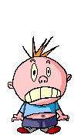

Randomness
Randomness in simulation:
  What is the average time a customer spends in the system? (from the moment she enters the system until she completes her process and leaves the system)
Average time
between
arrivals
is 60 minutes
Average
service time is
55 minutes
Photo
Processing
Arrival/Service Process
Result
Some queueing systems have analytical models! But not every system (even some simple systems) can be analytically modeled!
Constant/Constant
Random*/Constant
Random*/Random*

Slide 22
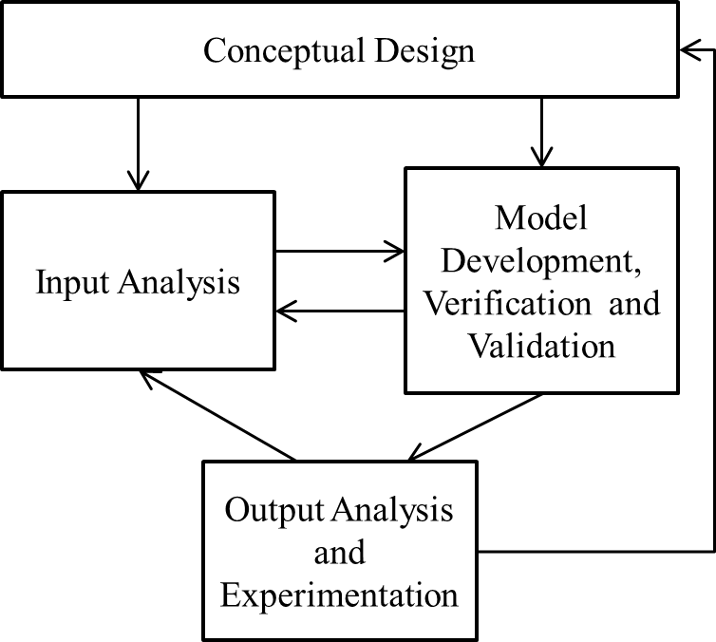
Simulation Process
Simulation process not strictly sequential
  More iterative process

Slide 23
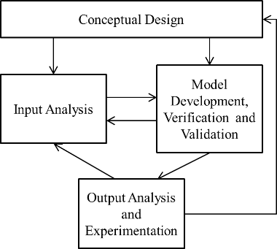
Simulation Process
Conceptual Design: Understand the system details
  Discuss the details of the problem and modeling approaches, outline the system and plans and models, know the simulation software and its capabilities (whether it can do what you need)
Input Analysis: characterize the system inputs
  Characterize random input variables: their distributions and processes
    Usually done via analyzing the past data on the variable/process
  Develop methodology to generate random observations using these characterizations
    Typically, most simulation software will have features to generate random observations
Model Development, Verification, and Validation: convert the conceptual model into an executable simulation model
  Requires carefully building the model using the software
  Verify that the model is working (nothing crazy going on, some expectations are met)
  Validation ensures the accuracy of the system
Output Analysis and Experimentation: collect information and analyze
  Know what metrics are important and collect data accordingly
  Characterize the collected data (recall that output will be random too)
  Set up experiments to investigate different settings

Slide 24
Outline
Simulation Process
  Simulation, Systems and Models
  Randomness and the Simulation Process
Simulation Approach
  When to Simulate (and When Not to)
  Simulation Success Skills
Review and System Examples

Slide 25
When to Simulate
If a valid model of the system is simple enough to model analytically and get exact results, then don’t simulate
  Key word: valid … probably possible for only the very simplest of systems
If system becomes complicated, it’s tempting to over-simplify the assumptions to get to an analytically tractable model
  Advantage is that you get exact answers, no uncertainty or noise
  But what good is an exact answer to the wrong model?
  Solving the (perhaps-unrealistic) model vs. solving the real problem
Use simulation when
  complete mathematical formulation does not exist or an analytical solution can not be developed.
  analytical methods are available, but mathematical procedures are so complex such that simulation provides a simpler solution.
  it is desired to observe a simulated history of the process over a period of time in addition to estimating certain system performances

Slide 26
When to Simulate
Do not simulate when (not from the book)
  the problem can be solved using a common sense
  the problem can be solved analytically
  it is easier to perform direct experiments
  cost exceeds savings
  proper resources are not available
  there is not enough time for the results to be useful
  there is no data – not even estimates
  can not do verification and validation
  project expectations can not be met
  system behavior is too complex or can not be defined

Slide 27
When to Simulate
Disadvantage of (stochastic) simulation – answers are just statistical estimates with uncertainty and noise
  Need to design, statistically analyze simulation experiments
  Can measure uncertainty/noise, take steps to reduce to tolerable level
    But you must be aware of this and consider it
It’s better to get a sufficiently precise estimated answer to the right model, than an exact answer to the wrong model
  Some statistical variation in the answers can be expected when using different versions of the same software on the same model
    e.g., Change in order of processing simultaneous events
    But even for a stochastic model, should get the same results from multiple executions of the same model in the same software version
      Random-number generators aren’t really random … desirable

Slide 28
When to Simulate
Capabilities and advantages of simulation (not from the book):
  can identify bottlenecks in the system
  can provide: insight into the system’s behavior, detailed output, understanding how the system really operates
  time compression and expansion
  explore possibilities (what if questions)
  diagnose problems and identify constraints
  requires fewer assumptions
  handles randomness and uncertainty
  display dynamic behavior
  flexible and easy to change
  credible and results are easier to explain
  can be used to verify and reinforce analytical methods and solutions

Slide 29
When to Simulate
Limitations and disadvantages(?) of simulation (not from the book):
  “RUN” rather than “SOLVED”
  can not generate an optimal solution on their own whereas analytical models can
  random output obtained from stochastic simulations (i.e., statistical analysis of output is required)
  requires specialized training in
    probability and statistics
    computer programming
    system analysis
    simulation methodology
  Costly? (software and hardware)

Slide 30
Simulation Success Skills
To successfully use simulation, the following should be considered
  Project Objectives:
    Stakeholder – Someone who commissions, funds, uses, or is affected by a simulation project
    Conflicting objectives between different stakeholders are not uncommon
    There is no “single simulation model” for a system – the “right” model depends on a combination of the system and the study objectives:
      What do you want to evaluate, learn, or hope to prove?
      What’s the scope of the project? How much detail is anticipated for each component of the system?
      What components are critical? Which less-important components can be approximated?
      What data are available or can be collected? How good is it? Who will provide them and when?
      How much experimentation will be required?
      Are animations needed? To what extent?
      In what form do you want the results?

Slide 31
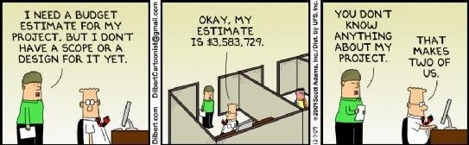
Simulation Success Skills
To successfully use simulation, the following should be considered
  Functional Specification:
    Functional specification – a document describing exactly what will be delivered, when, how, and by whom
  For most models, typical components in a functional specification are:
    Objectives, System description and modeling approach, Input data required, Expected experimentation, Output Data, Deliverables, Project Phases…
  From practical experience, approximately 5-10% of a project’s total time should be spent on developing the objectives and functional specification.
  This is NOT extra time, but rather moving selected important work to the beginning of the project where it can be used for planning and estimating the work.

Slide 32
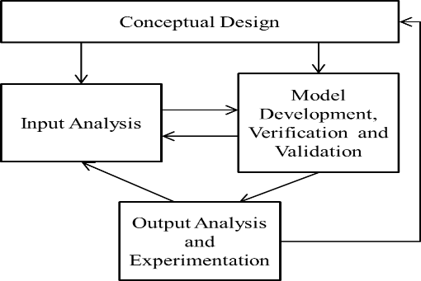

Simulation Success Skills
To successfully use simulation, the following should be considered
  Project Iterations:
    Do not do: start modeling and keep adding to the model until it’s “complete,” and only then run the model.
    Do: Use an iterative model-building process
      Add features/model components
      Run/Test
      Repeat
    “Save early, save often!”
  Project Management and Agility:
    Pay attention to timeline and budget!
    Plan activities accordingly
      Time allocation
      Budget allocation

Slide 33
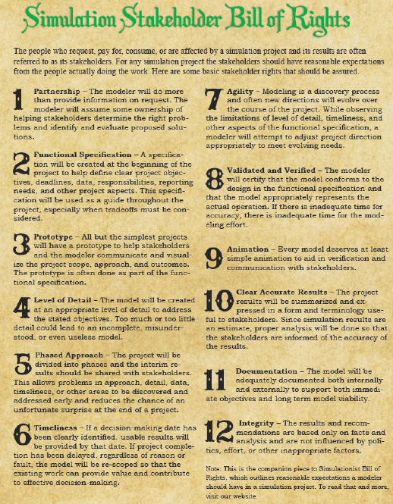
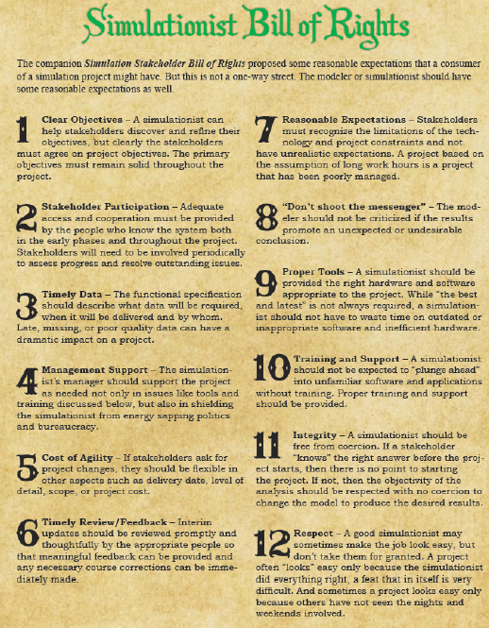
Simulation Success Skills
To successfully use simulation, the following should be considered
  Bill of Rights
    For Simulation Stakeholder – What your stakeholder can expect from you.
    For Simulationist – What you can expect from your stakeholders.
    Read SS Chapter 1.5.5

Slide 34
Outline
Simulation Process
  Simulation, Systems and Models
  Randomness and the Simulation Process
Simulation Approach
  When to Simulate (and When Not to)
  Simulation Success Skills
Review and System Examples

Slide 35
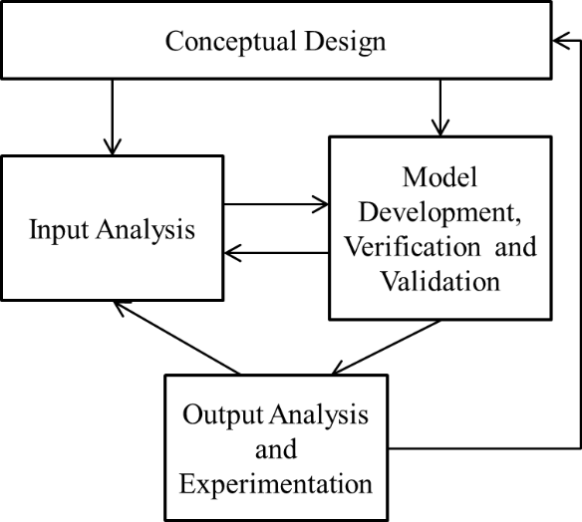
Review
A simulation is an approximate imitation of the operation of a process or system
Simulation types:
  Stochastic vs. Deterministic
  Static vs. Dynamic
  Discrete vs. Continuous
Input can be random → Then, output will be random
  Be mindful of the uncertainty of the output
Simulation process is iterative
Know when to and not to simulate
Manage the simulation project carefully

Slide 36
System Examples
Types of simulation: follow types of systems
Stochastic vs. Deterministic
Deterministic – no random inputs to model, so outputs are always the same (unless you change something in the model)
  Example 1: Suppose that you are controlling the inventory of a non-perishable product
    You count inventory at each day
    You know how many you sell each day
    Given your beginning inventory, you can calculate your ending inventory
    The system is deterministic
      No randomness in the input → demand is known, beginning inventory is known → ending inventory is known
  Example 2: Some physics laws

Slide 37
System Examples
Types of simulation: follow types of systems
Stochastic vs. Deterministic
Stochastic – random inputs to model to represent the realistic variation found in most systems (time to complete a task, time between successive arrivals of customers, machine uptimes and downtimes, branching probabilities)
  Example 1: Suppose that you are controlling the inventory of a perishable product
    Your inventory level changes as customers come to your store for buying the product
    Also, your inventory level changes as some products become obsolete
    You count the number of items remaining in your inventory at the end of the day
    You are interested in the how the ending inventory behaves
    The simulation model:
      Daily sales and probability of going obsolete will be input!
      Input Randomness:
        You do not know how many customers will come to your store to buy the product, so demand is random
        You do not know how many products will become obsolete as time to perish is not exactly known
      As you are interested in the inventory at the end of the day, the output data will be the ending inventory
      Output Randomness:
        Since, you do not know sales and you do not know # of products going obsolete, the output will change from day to day

Slide 38
System Examples
Types of simulation: follow types of systems
Stochastic vs. Deterministic
Stochastic – random inputs to model to represent the realistic variation found in most systems (time to complete a task, time between successive arrivals of customers, machine uptimes and downtimes, branching probabilities)
  Example 2: Battery level of an electric car
    Suppose that you drive an electric car
    The battery will continuously deplete as you drive
    The depletion rate depends on speed, the load in the car, the weather conditions, route-driving pattern (grade), as well as the age of battery
    You are interested in how the battery level changes over time
    The simulation model:
      Load, speed over time, weather conditions, the route, the equations to define energy consumption rate
      Input randomness: weather conditions, the speed might be random too (you do not know your exact speed at each moment)
      You are interested in the battery level trajectory
      Battery level at moment t will be random, as affected by the random input

Slide 39
System Examples
Types of simulation: follow types of systems
Static vs. Dynamic
Static – the time does not affect the system and its operation
  The output of the system does not depend on time, it just depends on the input
    If you have the same input at different times, you should have the same output at each of those times
  Example 1: Analyzing how much you can win in a gambling game → can generate outcomes randomly and see what happens → probability of winning a certain value does not change over time
  Example 2: The number seen after rolling the die
    The number you will see is random, however, it does not depend on time
  A static mathematical system
    F(x)=a*y(x), where a is a random variable
    The value of F(x) only depends on input x and the random a
    Input is random → a is random, so this is a stochastic system

Slide 40
System Examples
Types of simulation: follow types of systems
Static vs. Dynamic
Dynamic – the operations are depending on the time
  It is impossible to model the system without time dimension
  Operations/processes are related to each other over time
  A queueing system: customer’s interarrival times, customer service times, etc.
  Example 1: The number of customers adopting to a new product
    The adoption rate at a moment will depend on the exact moment, how many customers adopted up to that moment as well
  Example 2: The growth rate of a population
    It depends on the population size, as well as the ages of the individuals at the moment

Slide 41
System Examples
Types of simulation: follow types of systems
Discrete vs. Continuous (for dynamic systems)
Discrete – state variables describing the model change only at instantaneous discrete points in time (event times)
  Number of customers in queue, server status (busy, idle, down)
  Example 1: Consider the population of a species
    The population changes when there is a death or a birth
    So, the population changes at discrete time points
  Example 2: the inventory level
    The inventory level changes when there is a sale or when there is a new delivery
    So, the inventory level changes at discrete time points

Slide 42
System Examples
Types of simulation: follow types of systems
Discrete vs. Continuous (for dynamic systems)
Continuous – state variables can change continuously over time, described by differential equations that are solved numerically
  Pressure in a tank, temperature in an oven, fluid flow
  Example 1: Back to our battery example

